Slide 1


Quinolones and Fluroquinolones
Mrs. Pradnya Jagtap

Slide 2
INTRODUTION
The quinolones are a family of Synthetic, broad-spectrum antibiotic with bacterial activity.
The term quinolone refers to potent synthetic chemotherapeutic antibacterial agent.

Slide 3
Classification
Quinolones (1st generation ): e.g. Norfloxacin, Ciprofloxacin, Ofloxacin, Pefloxacin
High protein bound .
Mostly used in UTI
2nd generation: Levofloxacin, Moxifloxacin, Gemifloxacin, Prulifloxacin, Lomefloxacin, Sparfloxacin
Modified 1st generation quinolones
Not highly protein bound
wide distribution to urine and other tissues.
Limited CSF penetration.

Slide 4
1st Generation quinolones
- The first generation agents include Cinoxacin and Nalidixic acid, which are the oldest and least often used quinolons. - Because minimal serum levels are achieved, use of these drugs has been restricted to the treatment of uncomplicated urinary tract infections. - They are more susceptible to the development of bacterial resistance. These agents are not recommended for use in patients with poor renal function because of significantly urine concentration.

Slide 5
The second-generation quinolones have increased gram-negative activity ,as well as some gram-positive pathogen coverage. - Compared with first-generation drugs, these agents have broader clinical urinary tract infection and pyelonephritis, sexually transmitted diseases, selected pneumonias and skin infection. -Ciprofloxacin and ofloxacin are the most widely used because of their availability in oral and intravenous formulations.
2nd Generation quinolones

Slide 6
Newer Quinolones
Trovafloxacin : The current member, adds significant antimicrobial activity against anaerobes while maintaining the gram-positive and gram-negative activity of the second-generation quinolones species comparable to that of ciprofloxacin.
Because of concern about hepatotoxicity , trovafloxacin theory infections requiring inpatient treatment and the drug should be taken for no longer 14 days.

Slide 7
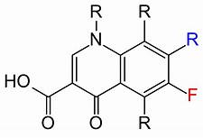
FLUOROQUINOLONES
The fluoroquinolones are a relatively new group of antibiotics
They were first introduced in 1986,but they are really modified quinolones , a class of antibiotics, whose accidental discovery occurred in the early 1960.

Slide 8
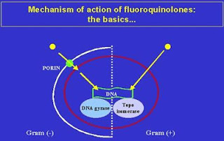
Mechanism of action

Slide 9
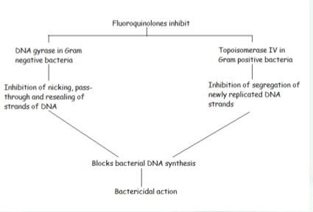

Slide 10
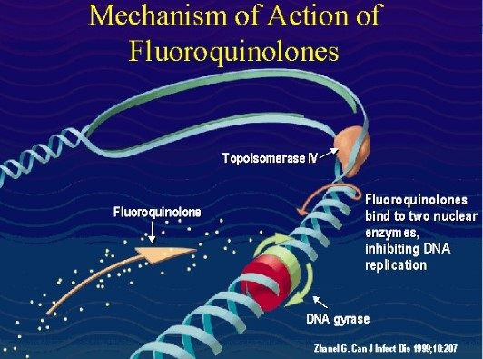

Slide 11
Mechanism of action Fluoroquinolones
Bind to the A-subunit od DNA gyrase
prevents the binding of substrate to the active site of DNA gyrase
Absence of formation of enzyme –substrate complex.
Blocked of unwinding of double- stranded DNA into a single stranded structure
Prevention of synthesis of RNA
Inhibition of bacterial protein synthesis
Antimicrobial activity

Slide 12
Resistance
1. Mutation in target enzyme: drug loose affinity
2. Change in the permeability of drug in organism.
3. Protection of DNA gyrase by some protein .

Slide 13
Pharmacokinetics
Absorption : Well absorbed orally with bioavailability
80-95% orally.
Distribution : Widely distributed in body fluids and tissues but limited CSF penetration . It can pass the placenta reaching to the foetus.
Half life : 3-8 hours in serum .
Elimination : 30-50% from urine by tubular secretion or glomercular filtration and some amount in bile- faces.

Slide 14
Uses
GIT infection :
Enteric fever: A potentially fatal multisystemic illness caused primarily by salmonella species.
Bacterial Diarrhoea : caused by campylobacter and salmonellae
Skin & soft tissue infections:
Infected ulcers : shallow wound that develops on the skin.
Infected burns : Red coloured and warm to touch due to an infection.
Gonorrhea : A venereal disease involving inflammatory discharge from the urethra or vagina.
Tuberculosis : Infection bacterial disease characterized by the white part of the eye and the inner surface of the eyelid.

Slide 15
UTI Respiratory tract infection

Slide 16
Adverse Effects
Quinolones may displace the neuro inhibitor GABA, resulting in CNS stimulants
Dizziness
Headache
Insomnia
Restlessness
Phototoxicity
Skin damage after exposure to uv light due to toxic reaction.
These included second degree burns, discoloration and sometimes permanent discoloration and scarring of the skin.
Other common side effects are:
Nausea
vomiting
Anorexia
Diarrhea.

Slide 17
INTERACTION
NSAID :
enhance the CNS toxicity of quinolones.
Theophylline , Caffeine or Warfarine
plasma concentration is increased by ciprofloxacin.
Antacid or iron salts
reduce the absorption of quinolones
CI:
Pregnancy
Age below 18
Arrythmia
Ca & Iron preparations
Theophylline toxicity

